Slide 1


It Takes a
Facebook Group
Constant Connectivity for
Volunteer Leaders
Presented by
Virginia Thomas, CMA (AAMA) | AAMA Leadership Development Strategy Team Chair
Jean Lynch | AAMA Marketing and Communications Director
AAMA 62nd Annual Conference
September 15, 2018 | Salt Lake City, Utah
Notes:
Last year the Leadership Development Strategy Team did a survey, like we often do, and asked the question “What additional resources would you like to see available on the Leader’s Center on the AAMA website?” One of the top responses was for an active forum or communication board on the website. I mentioned this to Jean at the planning session last November and we discussed the possibilities. And we would like to present to you an answer to your request. No, it will not be on the website, but actually where we spend a lot of our time.

Slide 2

We’ve all heard
it takes a village …

Well, that could apply to volunteer leaders too.
Notes:
So we have all heard that age old saying “It takes a village.” And this applies to us as volunteer leaders of the AAMA.

Slide 3
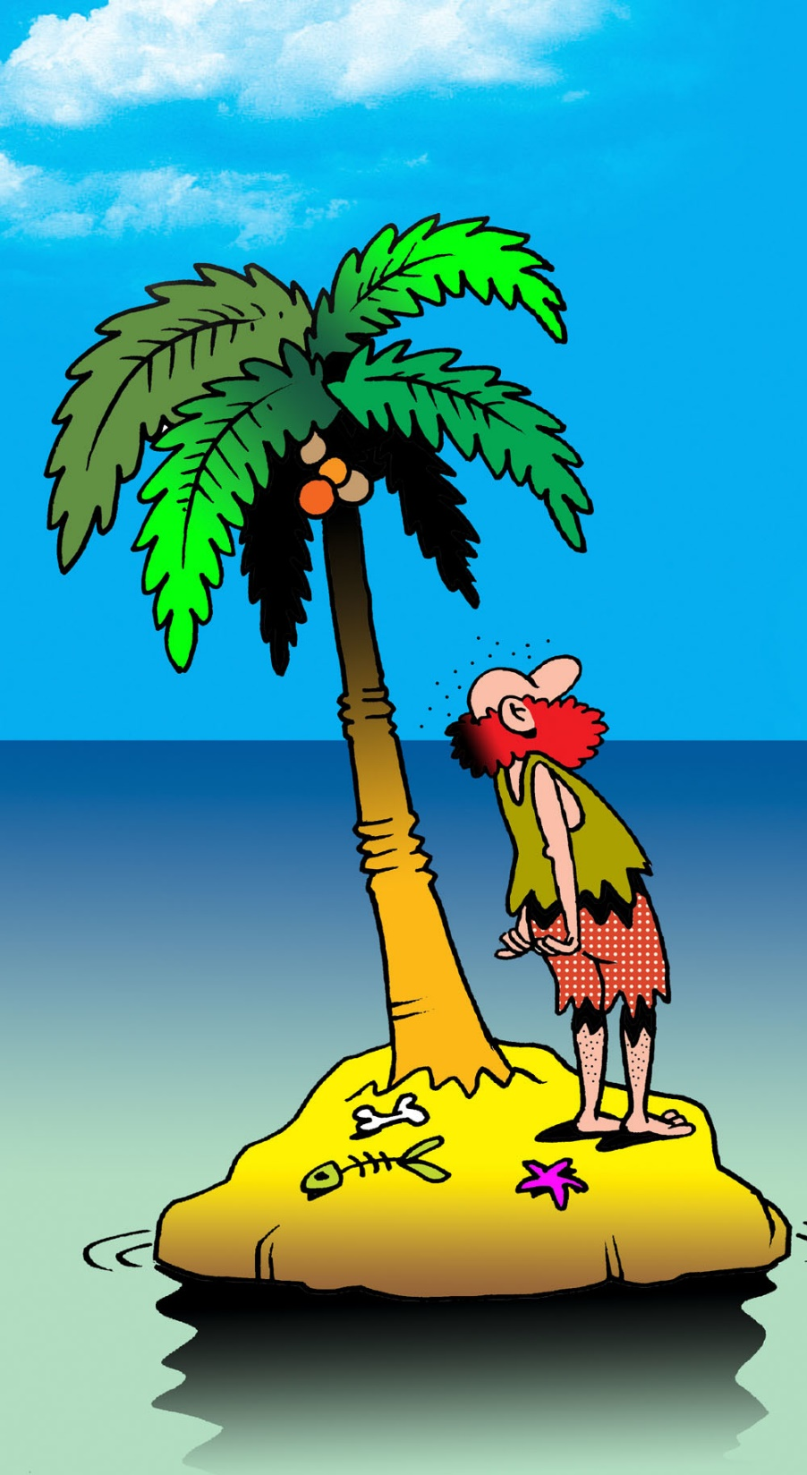
As volunteer leaders, we sometimes may feel like we are going it alone.

Slide 4

We signal for help,
but sometimes there are not
enough people to help or …
We signal for help, but there are not enough people to help or …
Notes:
There are just never enough people that want to or are interested in helping.

Slide 5
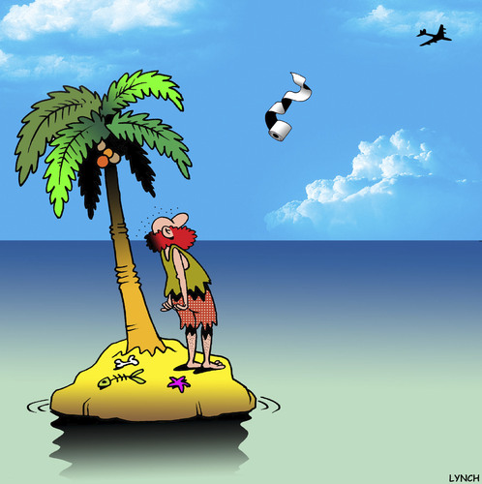
the help we get
is not exactly the help we need.

Slide 6
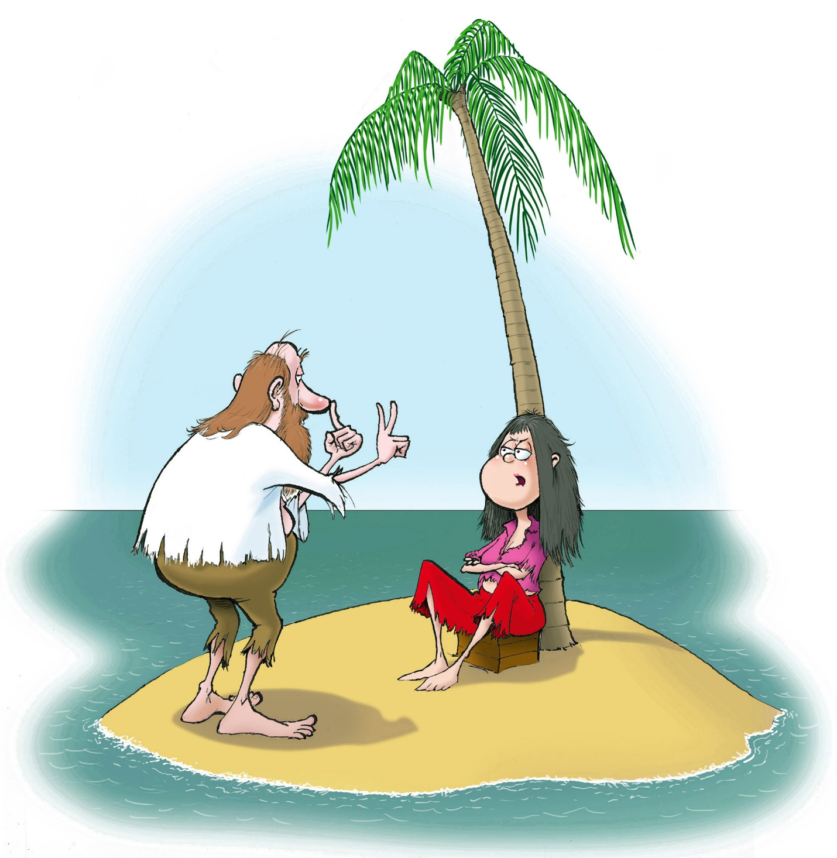
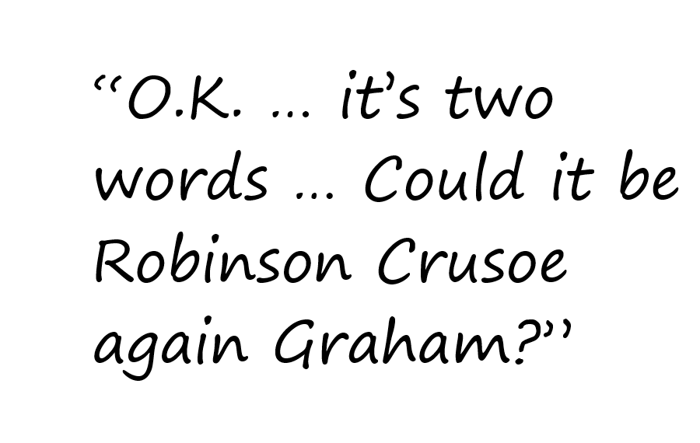
We might get
stuck in a rut …
Notes:
We find ourselves stuck in the “same old, same old” every year.

Slide 7
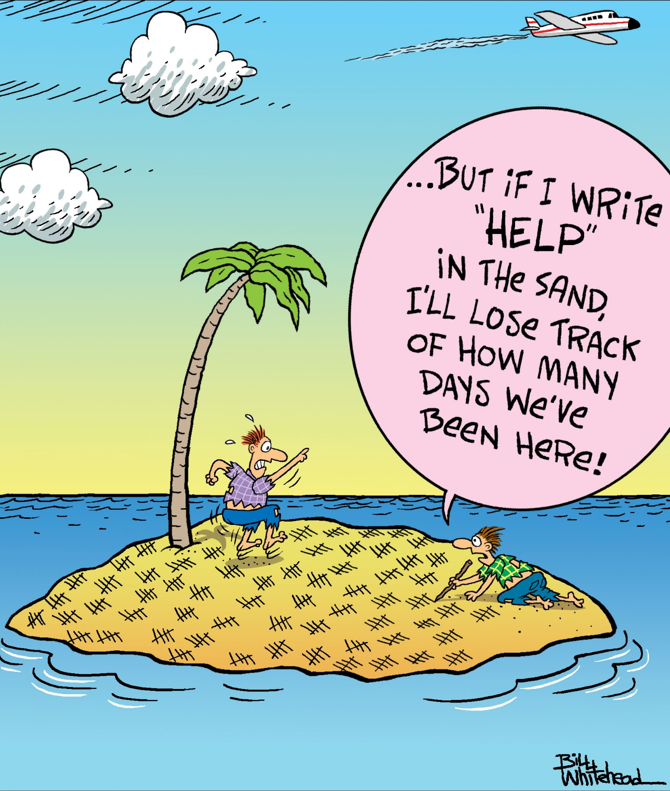
or lose our
focus.

Slide 8
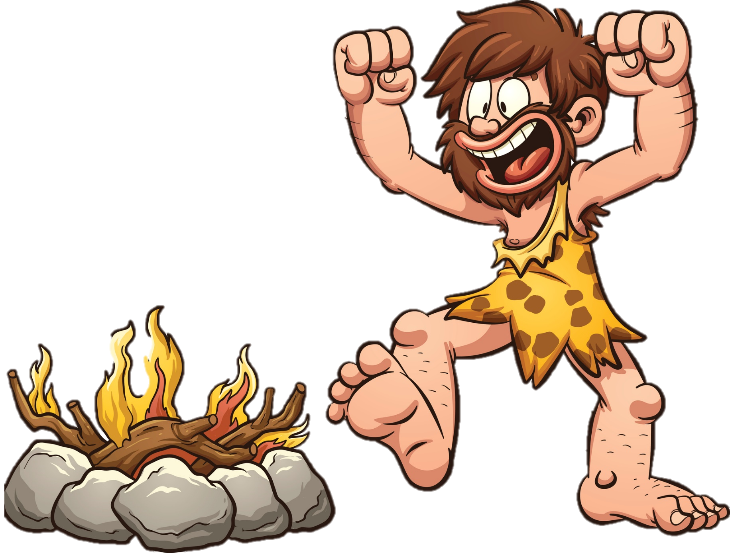
We have our triumphs …
but we all know …

Slide 9
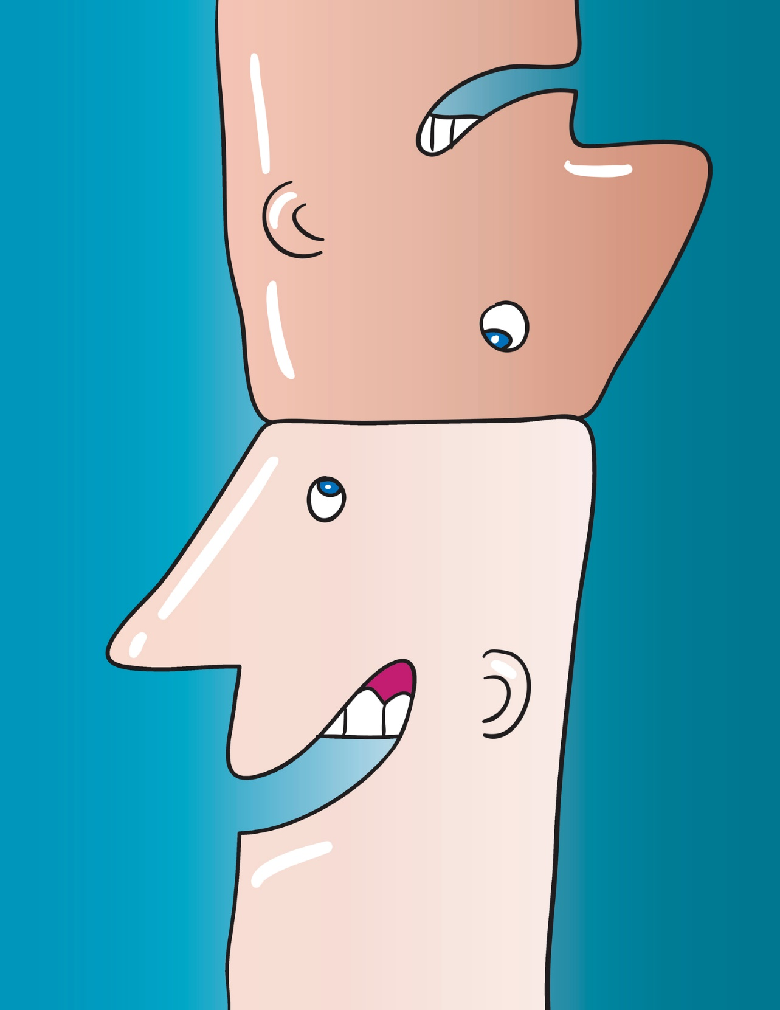
two heads are better than one.

Slide 10
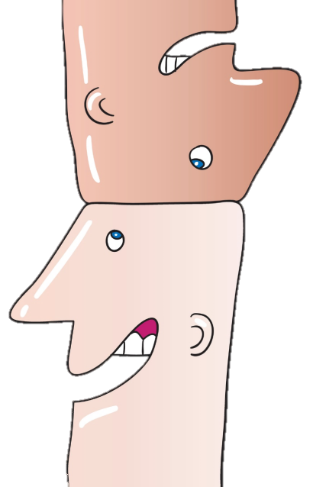
And more heads are better still.

Slide 11
Consider the words of Bill Gates:
The internet is becoming the town square for the global village of
tomorrow
Notes:
So let us consider what Bill Gates has to say about the internet – (read quote).
This has never been more true. We spend time on the internet at work doing authorizations and looking up information for patients. We spend time online shopping, playing games, browsing Facebook, Instagram and other forms of social media.

Slide 12

How do we harness this power?
Notes:
So how can we as volunteer leaders harness the power of the internet for ourselves?

Slide 13

How do we communicate effectively?

Slide 14
Consider where you are right now:
Gathered with other leaders
Exchanging ideas and information
Sharing advice and encouragement
Notes:
So let us think about where we are RIGHT now…
- We are in a room with leaders from all over the US.
- We are exchanging ideas and information to grow our chapter and state societies whether it be in this room, before or after a CEU session or over a cup of coffee or a meal.
- We are offering advice and lifting each other up. We give words of support and encouragement.
Be we only get to do this for about 4-5 days out of the year for the most part. But, what if there was a way to talk more often?

Slide 15

What if this room could become a virtual room?
Where you could
Instantly communicate
With other leaders
Nationwide
Every day, all year
Notes:
What if this room could become a virtual room where we can instantly talk to other leaders across the US any time of the day, 365 days a year?

Slide 16

A secret virtual room
Psssst!
Wanna join our secret group?
Notes:
A secret room…

Slide 17

Granting you a virtual key
Connecting you only with other volunteer leaders
Notes:
Which would grant you a key to be able to connect with only other volunteer leaders.

Slide 18

Introducing the newly constructed …
Facebook Group for AAMA Leaders
Notes:
I would like to introduce the new Facebook Group for AAMA Leaders

Slide 19

So how does it work?
Notes:
Jean and I are excited to introduce to you the new Facebook group dedicated to AAMA leaders. So how does it work? I will now hand it over to Jean Lynch, Director of Marketing and Communications, to take you through the steps. Jean…

Slide 20
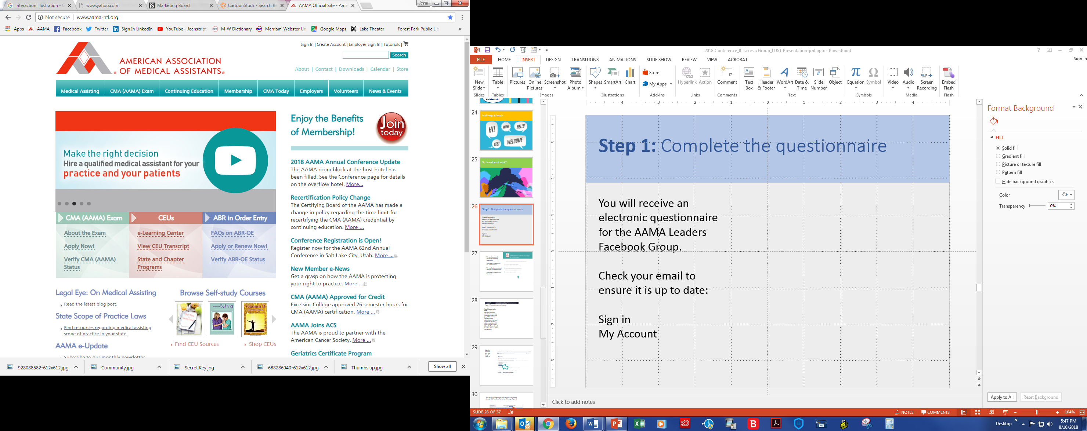
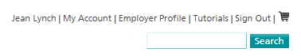
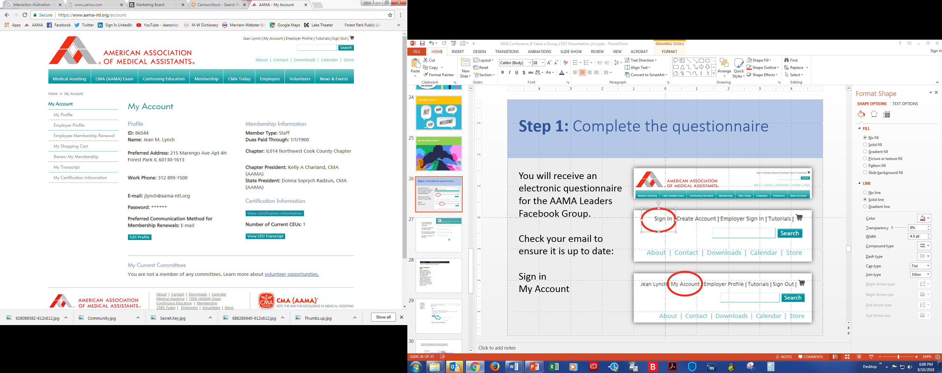
Step 1: Confirm your email address
Check your email to ensure it is up to date:
Sign In
My Account
Edit Profile
Notes:
Step 1: Confirm your email address on the AAMA website.
You need to sign in, go to My Account and Edit Profile.

Slide 21
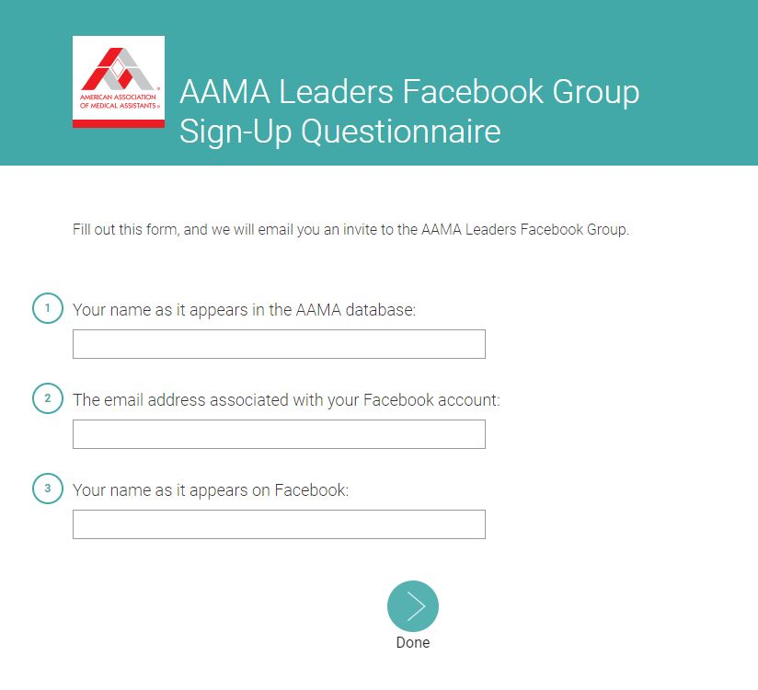
Step 2: Complete the questionnaire
You will receive a Leaders Facebook Group Sign-Up Questionnaire requesting:
Your name as it appears in the AAMA database
The email address used for your Facebook account
Your name as it appears on Facebook
Notes:
You will receive an email with a questionnaire. In it, we’ll ask for the email address you use for Facebook.

Slide 22
Step 3: Look for the invitation
You’ll receive an invite by email.
Check the email used for your Facebook account.
The sender will be either of two AAMA staff accounts:
AAMA MarCom Staff
M Lynn Sanks
Notes:
You’ll get an invite by email, so check the email you use for Facebook.
Look for an invite by AAMA MarCom Staff or M Lynn Sanks

Slide 23
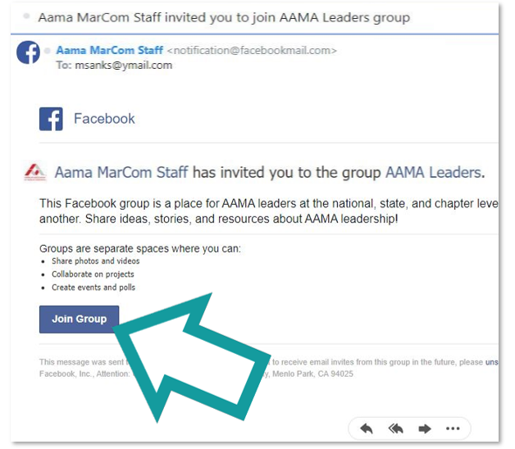
Step 4: Join the AAMA Leaders Group
Open
the email.
Click
“Join Group.”
Notes:
Once you get the invite, joining is easy! Open the invite and click on Join Group.

Slide 24
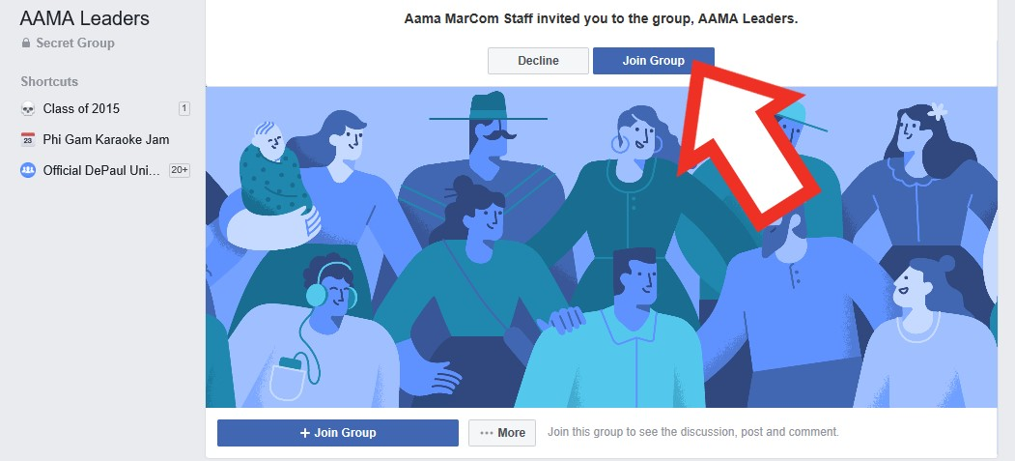
Step 5: Sign in & click “Join Group”
That’s it!
You will be
ready to engage!
Notes:
Sign in and click “Join Group” again.
That’s it!
Piece of cake!

Slide 25
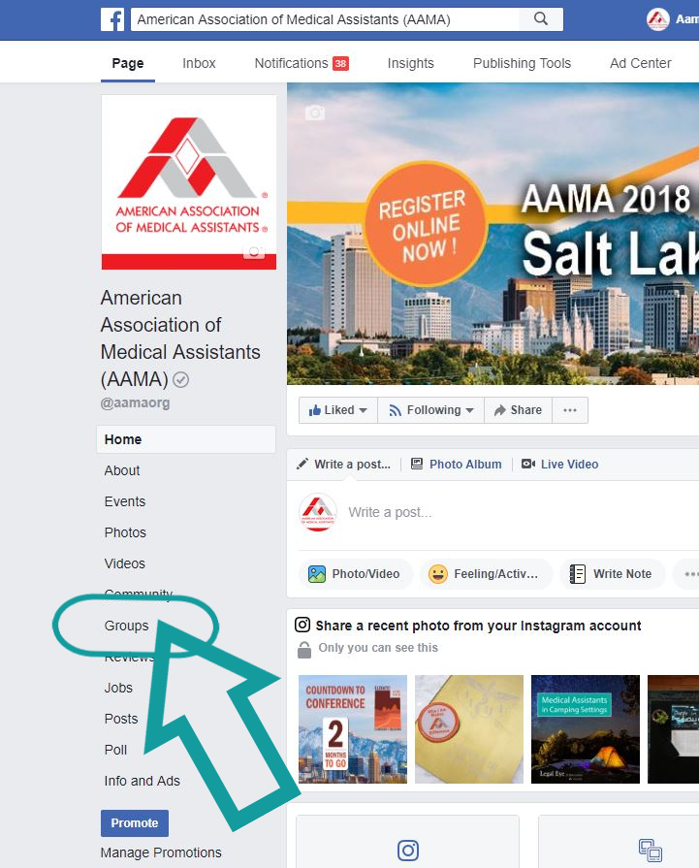
Navigation tips
Access the group
From the AAMA Facebook page or
your personal Home/News Feed page, click “Groups” on the left-side panel.
Notes:
How many people here already belong to a Facebook Group? Okay—you’re old hands.
For those who are new to it—it’s incredibly user friendly: just click on Groups in the left-hand column.

Slide 26
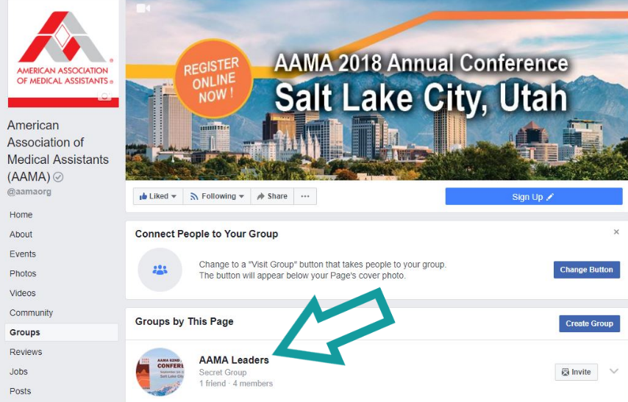

Navigation tips, cont.
Click “AAMA Leaders” under “Groups by This Page.”
Note: The landing page is the Discussion section of the group.
Notes:
Here’s where the names of all the Facebook groups you belong to appear.
Look for AAMA Leaders and click on it.

Slide 27
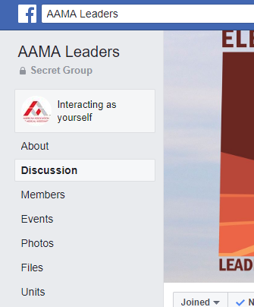
Navigation tips, cont.
Sections can be accessed on the
left-side panel.
Notes:
Once you are in the group, note the many other useful sections too.

Slide 28
Group section details
About: Review group purpose. Get an overview of members. View top recent posts.
Discussion: See all posts.
Announcements: See posts by AAMA staff.
Members: View a member list, including those with common interests, living in your area, and new to the group.
Notes:
About is a great place to view top recent posts among other general information. You’ll likely spend most of your time in Discussion where you can see all posts. Also, keep an eye on Announcements for timely staff updates and reminders. The Members section helps you to see who might live near you and share your interests. This is great for building your network.

Slide 29
Group section details, cont.
Events: Access shared events.
Videos: View shared videos.
Photos: View shared photos.
Files: Access shared documents.
Units: View posts organized into units.
Notes:
Most of these are self-explanatory, but let me point out the Files section. One of the coolest things about a group is you can actually share documents here. This is fantastic when you want to share a sample of your state materials to help out someone in another state.
You’ll also find the Community Standards and Policies under Files.
Units are cool too! [Next slide]

Slide 30
About units
Annual Meeting Planning
Bylaws
House of Delegates/General Assembly
Leadership and Management
Marketing
Medical Assistants Recognition Week
Membership Recruitment and Retention
News and Events
Program Planning
Publishing
Social Media and Websites
Strategic Issues Planning
Student Involvement
Units allow discussions to be categorized.
These units have been set up for your convenience.
Notes:
Units allow you to keep discussions from going totally off-road. Do you want to talk only to leaders working on similar projects? Jump into the related discussion group.

Slide 31
Privacy settings
Here’s the breakdown for a secret group’s privacy features:
Questions | Answers
Who can see the group's name? | Current members
Who can see the group description? | Current members
Who can see your membership in the group? | Current members
Who can see what members post in the group? | Current members
Who can find the group in Facebook search? | Current members
Who can request to join? | No one
Who can see stories about the group on Facebook (ex: News Feed)? | Current members
Who can see admins in the group? | Current members
Notes:
Now onto Privacy issues. As a Secret Group, the Leader Group has the tightest level of privacy for all Facebook groups.
As this chart shows, only current members can perform any function. The one exception is a request to join: no one can do that from within Facebook.
So, basically, no one outside the group can even see the group or search for it in Facebook.

Slide 32
Privacy notes
We ask participants not to share any information exchanged in this group with those outside the group.
Keep in mind, a Facebook Group is not by nature a confidential forum.
As with any other online content, anyone with access to the group has the capability to copy or take screenshots and share content publicly. There is no technical way for AAMA to prevent this type of information leaking.
Notes:
We want this group to be a safe and convenient place for leaders to communicate nationwide—a place to freely share ideas. Our Community Standards and Policies prohibit participants from sharing any information from this group with people outside the group. But remember, no online content is 100% secure. The AAMA has no way of policing people from, say, sharing a screenshot.
Avoid making any comments that you wouldn’t want your grandma to see. Keep it inspirational and aspirational and it will become a forum for all to enjoy.

Slide 33
Privacy notes, cont.
If you have confidential information to exchange, be sure to use another communication method that is more secure.
Never post your personal contact information nor that of others.
This group is subject to all terms and conditions of the AAMA Community Standards and Policies (posted under Files) and all Facebook terms of use. Any content that does not follow these usage guidelines will be deleted. Those who ignore these policies will be removed from the group.
Notes:
Avoid using this group to share confidential information. Use another venue that is more secure. You also should be wary of posting any personally identifiable information—whether it is yours or someone else’s. If you want to contact someone personally, use private Facebook Messaging to communicate one-on-one. These are just a few main points about privacy. Make sure you familiarize yourself with the AAMA Community Standards and Policies and Facebook terms of use. We will delete content that is not appropriate and group members will be removed if they ignore the policies.

Slide 34
Invite requests
Remember, no one can request to join a secret Facebook group from within Facebook.
However, state leaders who missed the initial invitation may email a request to the AAMA MarCom staff:
  AAMA Marketing and Communications MarCom@aama-ntl.org
Staff will verify the person’s eligibility to join.
Notes:
As mentioned earlier, no one can request an invite. But we want all leaders and future leaders to feel welcome, so there is a nice workaround: email us! We’ll verify a leader’s eligibility upon request.
National and state leaders can expect invites by the end of October and chapter leaders by the end of November.

Slide 35
Invite requests, cont.
Include the following information:
Name as it appears in the AAMA database
AAMA member ID
Leadership title and position
Facebook account email address
Name as it appears on Facebook
Instructions will be posted on the AAMA website.
Notes:
Here is the info we’ll need the leader to submit. These instructions are also posted on the AAMA website in the Volunteers/Guidelines and Forms, under the Documents/Leadership section.

Slide 36
Now you are ready to enter the newly constructed …
Facebook Group for AAMA Leaders
Notes:
So, now you’ll be ready to engage in the AAMA Leader Group. I’ll hand it back over to Virginia!

Slide 37

Where you—and other Super Leaders like you—will be connected
Notes:
So who is excited about this virtual room?

Slide 38

Where you can ask for help …
Going to a job fair.
What should I bring?
Looking for
speakers!
Where should I start?
Notes:
This tool will be a great place to ask other AAMA leaders for help…

Slide 39
Get advice …
What software do you recommend for …
e-Newsletters/e-Blasts
e-Surveys
Remote meetings
Notes:
To ask for advice…

Slide 40
Give advice …
Just launched Twitter!
Happy to help those just starting
out …
Notes:
To give advice to others…

Slide 41

Share information …
HOD? General Assembly?
What’s the diff?
We switched to General Assembly!
Here’s how we did it …
Notes:
To share information with others…

Slide 42
Even share documents …
Creating an Employer of the Year Award!
Need judging criteria samples stat.
New to
membership
marketing!
Any sample
materials you
can share?
Notes:
You can even share documents you have created to help guide another state…

Slide 43

Offer encouragement …
Was just looking at your state website—it’s terrific!
Notes:
A place to congratulate other leaders for a job well done

Slide 44
Give recognition …
Kudos to our
website manager: Stellar work!
Notes:
To recognize someone on their great work…

Slide 45

Share achievements …
Just presented at a local CAAHEP program.
Enrolled 12 new student members!
Notes:
Let others know about your achievements…

Slide 46
And triumphs …
Just launched Instagram!
We rocked MARWeek!
Sent out first
e-newsletter!
Notes:
And those exciting triumphs we just want to shout from the mountain top!

Slide 47
Get reminders from national staff …
Submissions are due for …
Conference
program ads
Delegates/Alternates
Excel Awards
Officer
elections
Representatives Bureau request
Notes:
The AAMA home office will send out reminders about due dates for important documents…

Slide 48
And hear from national leaders …
I’ve enjoyed serving on this team because …
Interested in serving on the national level?
Giving back to the profession
Building my network
Professional achievement
Mentoring others
Notes:
And you will even hear from national leaders…

Slide 49
From partnerships and leadership …
Help us help NCCRT spread the word about colorectal cancer!
~ Partnership Task Force
See who’s in the
Leader Spotlight!
So inspiring!
~ Leadership Development Strategy Team
Notes:
There will be announcements from national committees and strategy teams… like Partnership and Leadership Development…

Slide 50
To membership and social media …
New rosters are
ready for download!
~ Membership Development Strategy Team
Share your links:
We’ll follow you!
~ Social Media Subcommittee
Notes:
And Membership and Social Media.

Slide 51

Or simply keep in touch …
Notes:
Or … simply keep in touch with fellow leaders. The possibilities are endless!

Slide 52

Watch your email inbox
An invitation will be coming your way!
Notes:
So, national and state leaders: watch your email box in October for your invitation and come join us in our secret Facebook group!
Chapter leaders look for invites in November.

