Slide 1


Beginners’ Social Media Toolkit
For AAMA Leaders

Slide 2
Creating an Account

Slide 3
Creating Social Media Accounts
    Signing Up for Facebook
    https://www.youtube.com/watch?v=NaqR1bJCdiY
    Signing Up for Instagram
    https://www.youtube.com/watch?v=pJYSy0wsbIs
    https://www.youtube.com/watch?v=no55N1sHjT8
    Signing Up for Twitter
    https://www.youtube.com/watch?v=QJAibLM_FO0

Slide 4
Creating Social Media Accounts Cont.
    Signing Up for LinkedIn
    https://www.youtube.com/watch?v=qG4NF-2tt4c
    https://www.youtube.com/watch?v=jh5eDSMPvjE
    Signing Up for TikTok
    https://www.youtube.com/watch?v=9Dj6CJ7Phnw
    https://www.youtube.com/watch?v=VBKjFah9KpU

Slide 5
Engaging

Slide 6
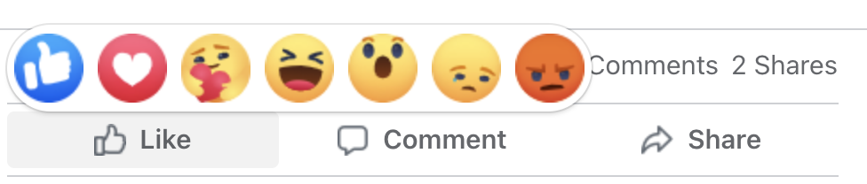
Engaging on Social Media
If you are uncomfortable creating your own content, engaging with content already created by the American Association of Medical Assistants® (AAMA) is a great way to show support.
How to Engage on Facebook
  Reacting to a post (like, love, care, etc.)
  Commenting on a post
  Sharing the post via your own feed
    Sharing is a vital way to reach more people on Facebook.
    When you share a post from the AAMA on your personal Facebook page, all your friends will then see the post.

Slide 7
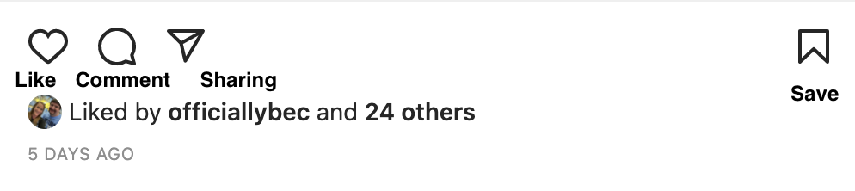
Engaging on Social Media Cont.
How to Engage on Instagram
  Liking a post
  Commenting on a post
  Sharing a post to your Instagram story
  Saving a post to a personal collection
  Sharing a post via direct message to others

Slide 8
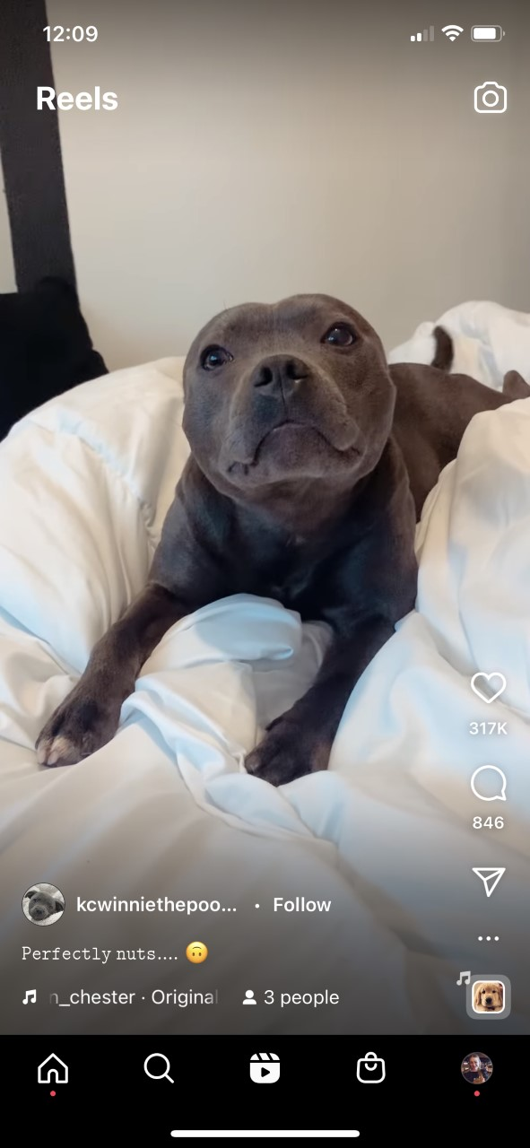
Engaging on Social Media Cont.
Instagram has a similar feature to TikTok called Instagram Reels within the Instagram app. The videos are only up to a minute long.
How to Engage on Instagram Reels
  Liking a video
  Commenting on a video
  Sharing a video

Slide 9
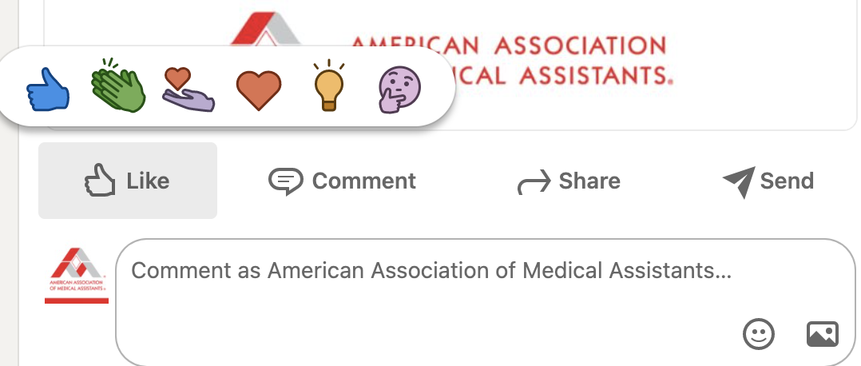
Engaging on Social Media Cont.
How to Engage on LinkedIn
  Reacting to a post (like, celebrate, love, etc.)
  Commenting on a post
  Sharing a post to your personal profile page
  Sending a post directly to others

Slide 10
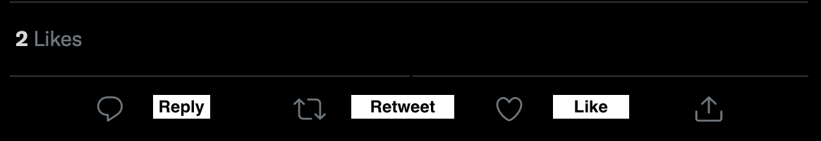
Engaging on Social Media Cont.
How to Engage on Twitter
  Liking a tweet
  Replying to a tweet
  Retweeting a tweet to your personal feed
  Sending a tweet directly to others via direct message

Slide 11
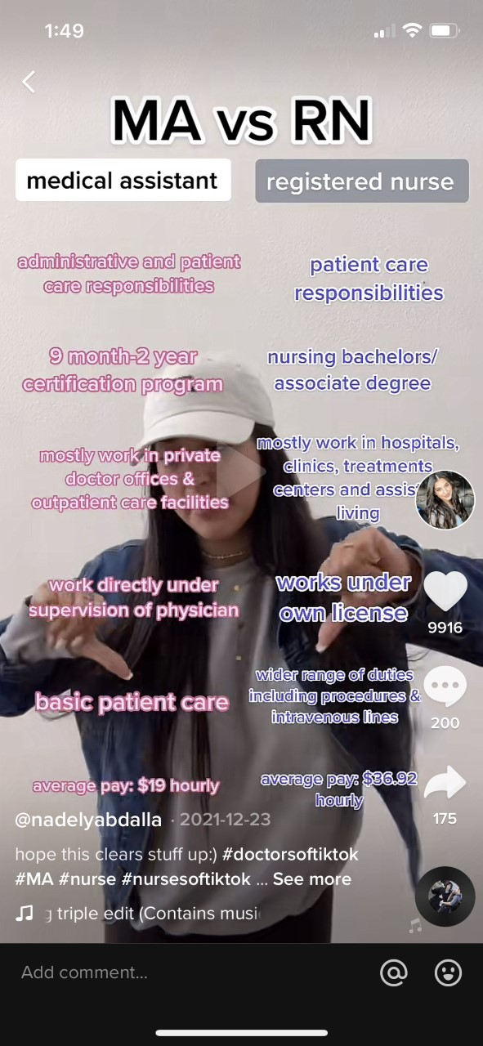
Engaging on Social Media Cont.
How to Engage on TikTok
  Liking a video
  Commenting on a video
  Sharing a video across platforms

Slide 12
How to Sign Up for AAMA Post Notifications

Slide 13
Notifications on Facebook
  To turn on notifications for a Facebook page follow these steps:
  Click the search bar in the top left of any page on Facebook.
  Enter the name of the Page and choose from the results.
  Go to the Page.
  Click the three dots then select “Follow” or “Following.”
  Click either “Follow settings” or “Manage follow settings” (depends on the device you’re using), which has now replaced “Follow” on the three dots’ drop-down.
  Below “Notifications” or “Notification Settings” on that “Follow settings” pop-up, select what types of content you want notifications for (i.e., posts, video, live video, and offers)
  Click the bell next to each type of content notification or simply click on the name of each content type (depends on the device you’re using) to select the degree to which you’d like to view each content type (i.e., all, highlights, or none).
  Each time this account posts those selected content types, you will get an alert on your phone.

Slide 14
Notifications on Instagram
  To turn on notifications for an Instagram page follow these steps:
  Visit the Instagram account you want to enable alerts for. Make sure you are already following the account.
  Tap the bell icon at the top right of your screen to make a notifications menu appear. (The bell icon is in the same place on both the iOS and Android app.)
  Toggle the sliders within the menu that appeared to select which types of content you want to get notifications for: posts, stories, videos, reels, and live video.
  Each time this account posts those selected content types, you will get an alert on your phone.
  Watch a how-to video: https://www.youtube.com/watch?v=5EiCqhqPYAg

Slide 15
Tagging the AAMA

Slide 16
How to Tag on Facebook
  Whether you’re creating a post or replying via a comment, these are the steps to tag a profile or page:
  Type your message as usual until you get to the point you want to tag someone’s page or profile.
  Type “@” and then, with no spaces after the symbol, type the name of the page or profile you want to tag.
  Choose your desired page or profile when a drop-down of options appears as you type.
  Finish typing your message, if applicable.
  Post.
  How to tag someone in a photo: https://www.youtube.com/watch?v=jlT1jgKPOv0

Slide 17
How to Tag on Instagram
  For creating a post or replying via a comment, these are the steps to tag a profile or page:
  Type your message as usual until you get to the point you want to tag someone’s page or profile.
  Type “@” and then, with no spaces after the symbol, type the name of the page or profile you want to tag.
  Choose your desired page or profile when a drop-down of options appears as you type.
  Finish typing your message, if applicable.
  Post.
  For posting a new photo, these are the steps to tag people or a business:
  Tap the “Tag People” button as you’re uploading a photo.
  Tap on the person or object in the photo you want to tag.
  Type in the username and it should appear from a drop-down menu. Click it.
  Tap “Done,” “Share,” or the checkmark (depending on the device you’re using).
  How to tag someone in a post: https://www.youtube.com/watch?v=t8yHpSycwJA
  How to tag someone in an Instagram story: https://www.youtube.com/watch?v=B8D-cogk64w

Slide 18
How to Tag on LinkedIn
  Whether you’re creating a post or replying via a comment, these are the steps to tag a profile or page:
  Type your message as usual until you get to the point you want to tag someone’s page or profile.
  Type “@” and then, with no spaces after the symbol, type the name of the page or profile you want to tag.
  Choose your desired page or profile when a drop-down of options appears as you type.
  Finish typing your message, if applicable.
  Post.
  How to tag people and companies in a post:
  https://www.youtube.com/watch?v=3egBhidZwmc

Slide 19
How to Tag on TikTok
  Whether you’re creating a post or replying via a comment, these are the steps to tag a profile or page:
  Type your message as usual until you get to the point you want to tag someone’s page or profile.
  Type “@” and then, with no spaces after the symbol, type the name of the page or profile you want to tag.
  Choose your desired page or profile when a drop-down of options appears as you type.
  Finish typing your message, if applicable.
  Post.
  How to tag someone in a post using an iPhone or Android: https://www.youtube.com/watch?v=14rsnaUbEBU
  How to tag someone in a post: https://www.youtube.com/watch?v=74106SYJsiY

Slide 20
How to Tag on Twitter
  Whether you’re creating a tweet, quote tweeting, or replying via a comment, these are the steps to tag a profile or page:
  Type your message as usual until you get to the point you want to tag someone’s page or profile.
  Type “@” and then, with no spaces after the symbol, type the name of the page or profile you want to tag.
  Choose your desired page or profile when a drop-down of options appears as you type.
  Finish typing your message, if applicable.
  Post.
  How to tag someone on Twitter: https://www.youtube.com/watch?v=Cd_dTqQoPbo

Slide 21
Hashtags

Slide 22
What Is a Hashtag?
A hashtag is a label used to make it easier to find posts or information with a theme or that contains specific content.
Hashtags are made by combining the pound sign with a word or a series of words related to the content of the post.
When creating a hashtag, capitalize the first letter of each word to improve accessibility.
Examples of hashtags include the following:
  #MedicalAssistants #MedicalAssisting #CertifiedMedicalAssistant #MedicalNews #HealthCare #Medicine

Slide 23
The Importance of Hashtags
Searching a hashtag pulls results of each post using that hashtag.
  For example, when someone looking for posts on medical assistants searches #MedicalAssistants, all posts who have that within their post caption will be featured, usually by either the most recently posted or most engagement.
Hashtags make it easier for users to find relevant information.
Hashtags are used on most social media platforms.

Slide 24
When to Use a Hashtag
Use hashtags whenever you create and share a post on social media.
Add hashtags that are relevant to the content of your post.
  For example, if you create a post highlighting the benefits of being a medical assistant, here are some hashtags you can use:
    #MedicalAssistant #MedicalAssisting #CertifiedMedicalAssistant #Medical #MedicalLife #WomenInMedicine
You can also use hashtags to find similar posts to inspire your creativity when creating content.

Slide 25
Content Creation
Picture and Video Content

Slide 26
What Kind of Content Should You Create?
Content Promoting the General Awareness of the Medical Assisting Field
  What it is like being a medical assistant
  Why you became a medical assistant
  Why you have stayed in the profession, even during the pandemic
  Benefits to being a medical assistant
  Skills or tools helped you get into the profession
  How becoming a medical assistant influenced you as an individual
  Advice you have for anyone looking to enter the profession
  Tips or tricks you have learned or wish you had learned sooner

Slide 27
What Kind of Content Should I Create?
Content Promoting Awareness of the CMA (AAMA)® Credential
  How the credential has benefited your career
  What made you choose this credential
  How the credential prepared you to enter the profession
  Your experience representing the credential within the profession
  Continuing education opportunities that had a major positive impact on your career and general professional knowledge

Slide 28
What Kind of Content Should I Create?
Content Promoting the AAMA Organization
  What it is like being a part of an AAMA state society and/or local chapter
  How the organization has supported you in the profession
  Why you joined the organization
  Why you became a leader within the organization
  The benefits you have experienced and seen for yourself and other medical assistants from AAMA membership
  The impact of being involved in AAMA events like state conferences or the AAMA Annual Conference

Slide 29
How to Make Videos for Social Media

Slide 30
Tips for Making Videos
Look More Professional
Use your smartphone.
  Smartphones today have high-quality visual and audio technology.
  Use the camera on the back of the phone as it is higher quality.
  Record in landscape mode (horizontally instead of vertically).
Stabilize your phone.
  Keeping your phone steady is important.
  Invest in a tripod or use items at home to keep your phone still and focused.
Use plenty of light.
  Natural light is the best light for videos, but lamps also work great.
Use a clean background.
  Nothing looks more unprofessional than a messy or distracting background.

Slide 31
Tips for Making Videos
Look More Professional
Keep your editing simple.
  Use noise canceling to clean up background noise.
  Adjust the lighting.
  Cut out awkward pauses.
Clear audio.
  The audio is more important than how the video looks. If people do not know what you are saying, your message will be lost.
Add subtitles.
  Including subtitles can help combat low-quality audio and make the video more accessible to viewers.
Have fun.
  These videos are meant to be fun and do not need to be perfect.
Practice is everything.
  Trying things out is the first step. Take videos of your friends or family as practice.

Slide 32
Editing Apps
Videoshop
  Available on the Apple Store for free
  Most features are free and easy to use
iMovie
  Free on the Apple Store
  Allows editing on an Apple computer and synching right to your phone
Quik by GoPro
  A free editing app for both Android and Apple
TikTok
  Available on the Apple and Google store for free
  Create and edit right in the app

Slide 33
Helpful Articles for Using TikTok
”How To Make TikTok Videos for Beginners” (brandsynario.com)
“How to Use TikTok: Beginners Start Here” (hootsuite.com)
“How to Use TikTok | The Ultimate Guide for Beginners” (influencermarketinghub.com)
“How to Use TikTok – A Beginner’s Guide” (techjunkie.com)

Slide 34
Helpful YouTube Videos for Using TikTok
“How To Edit Videos On Your Phone”
“How to Edit Videos on Android (COMPLETE Beginner’s Guide!)”
“How to Film + Edit on your iPhone! Beginners Guide”
“How to Make YouTube Videos with Your PHONE”
“How to Edit a TikTok Video 2021 - Tik Tok Editing Tutorial”
“TikTok Tutorial: How to Make TikTok Videos for Beginners”

Slide 35
Helpful YouTube Videos for Using Instagram Reels
Beginners Guide to Instagram Reels - How to Make Reels on IG – YouTube
15 Instagram REELS Tips, Tricks & Hacks | YOU MUST KNOW!!! – YouTube
UPDATED INSTAGRAM REELS TUTORIAL 2022 | Everything you need to know step by step - YouTube

Slide 36
Questions?
Contact the AAMA Marketing and Communications Department at MarCom@aama-ntl.org.

